Slide 1
Vectors

Slide 2
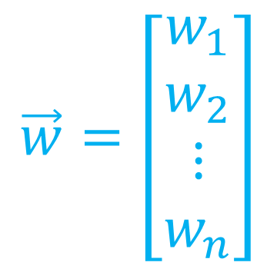

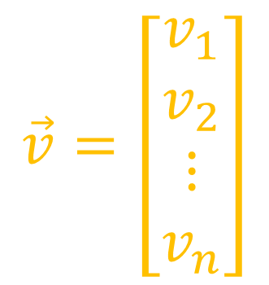
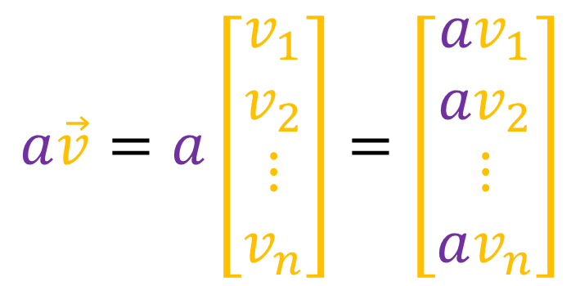
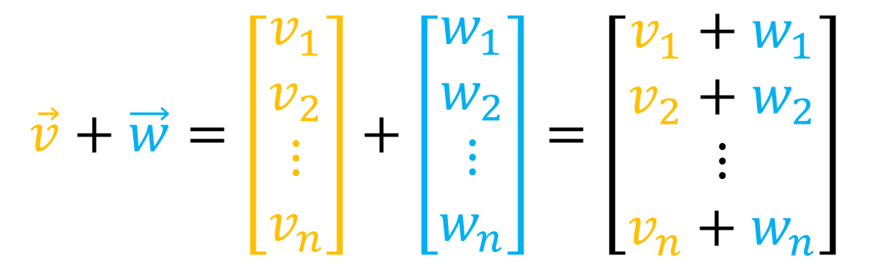
What is a vector?
1. It’s a list of numbers
$$\vec{v}=\left[\begin{aligned}v_{1} \\ v_{2} \\ ⋮ \\ v_{n}\end{aligned}\right]$$
$$\vec{v}+\vec{w}=\left[\begin{aligned}v_{1} \\ v_{2} \\ ⋮ \\ v_{n}\end{aligned}\right]+\left[\begin{aligned}w_{1} \\ w_{2} \\ ⋮ \\ w_{n}\end{aligned}\right]=\left[\begin{aligned}v_{1}+w_{1} \\ v_{2}+w_{2} \\ ⋮ \\ v_{n}+w_{n}\end{aligned}\right]$$
$$\vec{w}=\left[\begin{aligned}w_{1} \\ w_{2} \\ ⋮ \\ w_{n}\end{aligned}\right]$$
$$a\vec{v}=a\left[\begin{aligned}v_{1} \\ v_{2} \\ ⋮ \\ v_{n}\end{aligned}\right]=\left[\begin{aligned}{av}_{1} \\ {av}_{2} \\ ⋮ \\ av_{n}\end{aligned}\right]$$
Problem:
These are really vector components!

Slide 3
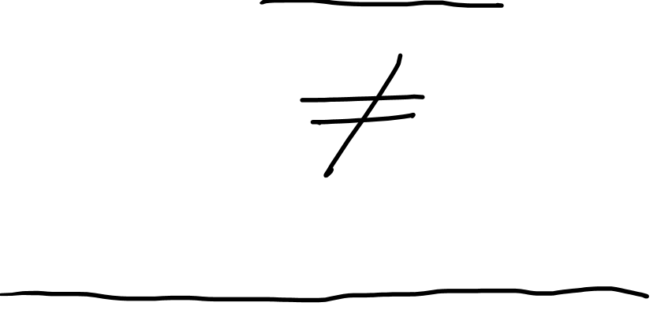
Vectors are Invariant Vector components are not invariant

Slide 4






What is a vector?
2. It’s like an arrow
$$\vec{v}+\vec{w}$$
$$\vec{v}$$
$$\vec{w}$$
$$\vec{v}$$
$$\vec{w}$$

Slide 5
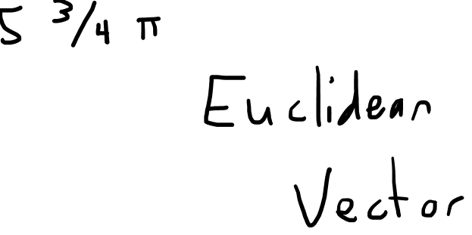




What is a vector?
2. It’s like an arrow
$$\vec{w}$$
$$2\vec{w}$$
$$\vec{v}$$
$$(−1)\vec{v}$$
Problem:
Not all vectors can be visualized as arrows!

Slide 6

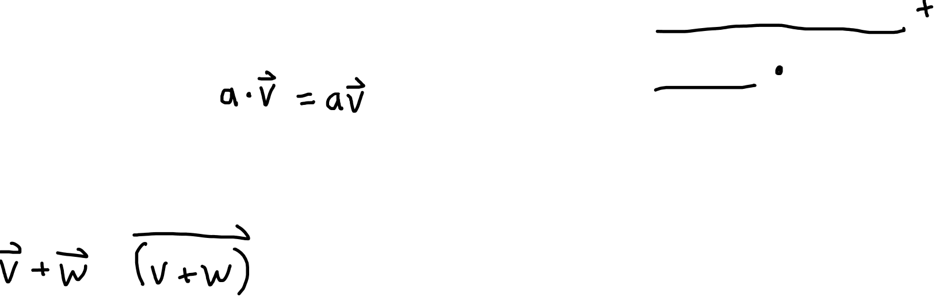
What is a vector?
3. It’s a member of a Vector Space
$$(V,S,+,⋅)$$
Basically:
Vectors are things that
we can add together
we can scale
Set of Vectors
Vector scaling rule
Set of Scalars
Vector addition rule

Slide 7


What are the components of $\vec{v}$?
Answer: You don’t know!
In order to get components, we need to measure a vector using a basis.
A vector is not its components!
A vector is a combination of components and basis vectors!
$$\vec{v}$$

Slide 8

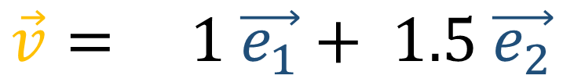
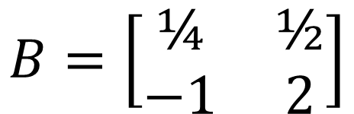

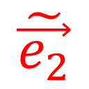
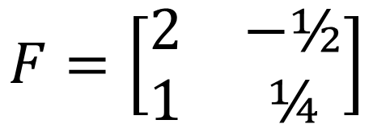
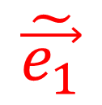

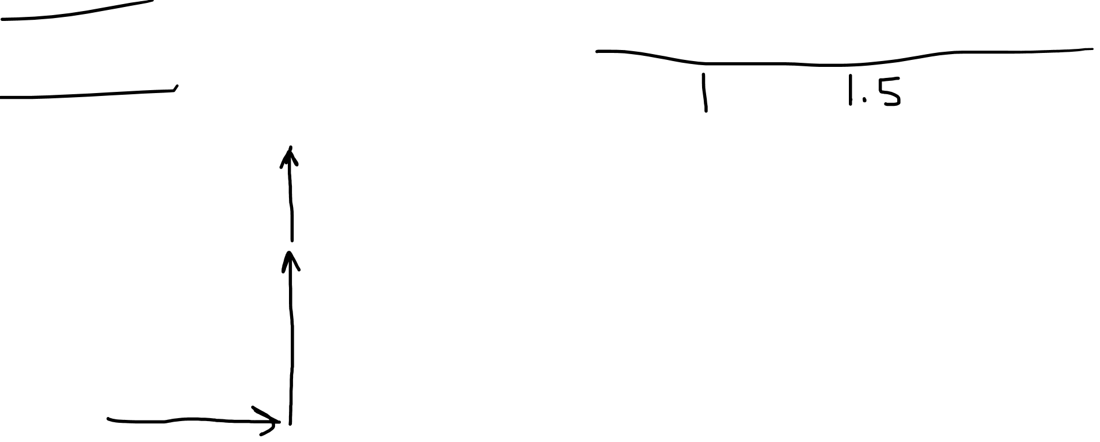

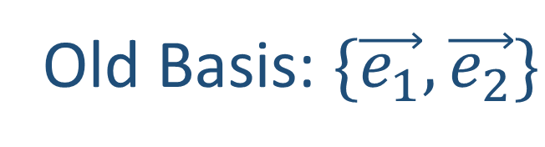
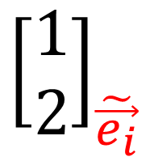
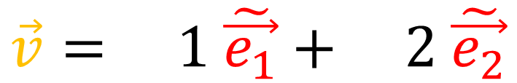

Old Basis: $\{\vec{e_{1}},\vec{e_{2}}\}$
$$F=\left[\begin{matrix}2 & −\text{½} \\ 1 & \text{¼}\end{matrix}\right]$$
$$B=\left[\begin{matrix}\text{¼} & \text{½} \\ −\text{1} & \text{2}\end{matrix}\right]$$
New Basis: $\{\tilde{\vec{e_{1}}},\tilde{\vec{e_{2}}}\}$
$$\vec{v}= 1 \vec{e_{1}}+ 1.5 \vec{e_{2}}$$
$$\vec{v}$$
$$\vec{v}= 1 \tilde{\vec{e_{1}}}+ \text{2 }\tilde{\vec{e_{2}}}$$
$$\vec{e_{2}}$$
$$\tilde{\vec{e_{1}}}$$
$$\tilde{\vec{e_{2}}}$$
$${\left[\begin{matrix}1 \\ 1.5\end{matrix}\right]}_{\vec{e_{i}}}$$
$${\left[\begin{matrix}1 \\ 2\end{matrix}\right]}_{\tilde{\vec{e_{i}}}}$$
$$\vec{e_{1}}$$

Slide 9
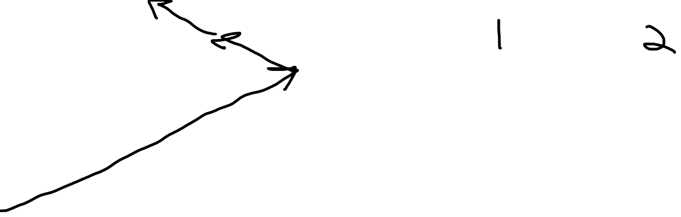
Old Basis: $\{\vec{e_{1}},\vec{e_{2}}\}$
$$F=\left[\begin{matrix}2 & −\text{½} \\ 1 & \text{¼}\end{matrix}\right]$$
$$B=\left[\begin{matrix}\text{¼} & \text{½} \\ −\text{1} & \text{2}\end{matrix}\right]$$
New Basis: $\{\tilde{\vec{e_{1}}},\tilde{\vec{e_{2}}}\}$
$$\vec{v}= 1 \vec{e_{1}}+ 1.5 \vec{e_{2}}$$
$$\vec{v}$$
$$\vec{e_{2}}$$
$$\vec{v}= 1 \tilde{\vec{e_{1}}}+ \text{2 }\tilde{\vec{e_{2}}}$$
$$\tilde{\vec{e_{1}}}$$
$$\tilde{\vec{e_{2}}}$$
$${\left[\begin{matrix}1 \\ 1.5\end{matrix}\right]}_{\vec{e_{i}}}$$
$${\left[\begin{matrix}1 \\ 2\end{matrix}\right]}_{\tilde{\vec{e_{i}}}}$$
$$\vec{e_{1}}$$

Slide 10
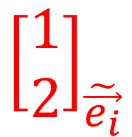
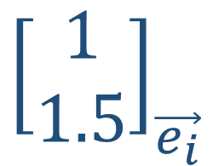
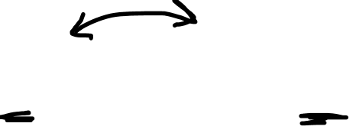
Old Basis: $\{\vec{e_{1}},\vec{e_{2}}\}$
$$F=\left[\begin{matrix}2 & −\text{½} \\ 1 & \text{¼}\end{matrix}\right]$$
$$B=\left[\begin{matrix}\text{¼} & \text{½} \\ −\text{1} & \text{2}\end{matrix}\right]$$
New Basis: $\{\tilde{\vec{e_{1}}},\tilde{\vec{e_{2}}}\}$
$$\vec{v}= 1 \vec{e_{1}}+ 1.5 \vec{e_{2}}$$
$$\vec{v}$$
$$\vec{e_{2}}$$
$$\vec{v}= 1 \tilde{\vec{e_{1}}}+ \text{2 }\tilde{\vec{e_{2}}}$$
$$\tilde{\vec{e_{1}}}$$
$$\tilde{\vec{e_{2}}}$$
$${\left[\begin{matrix}1 \\ 1.5\end{matrix}\right]}_{\vec{e_{i}}}$$
$${\left[\begin{matrix}1 \\ 2\end{matrix}\right]}_{\tilde{\vec{e_{i}}}}$$
$$\vec{e_{1}}$$

Slide 11
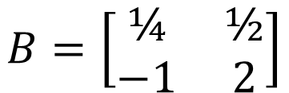

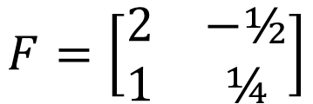
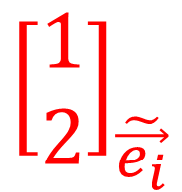
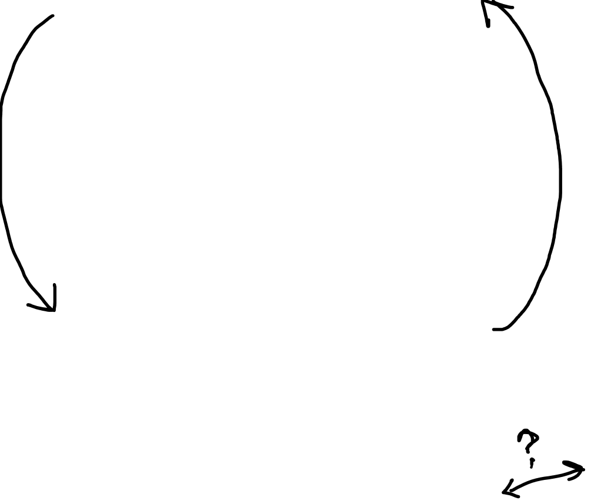
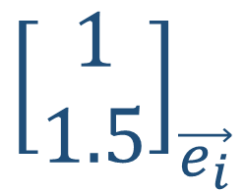
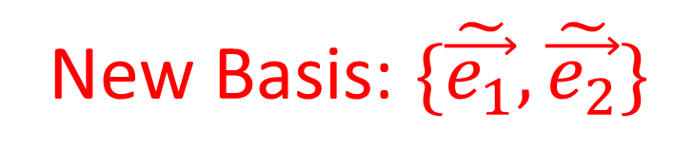
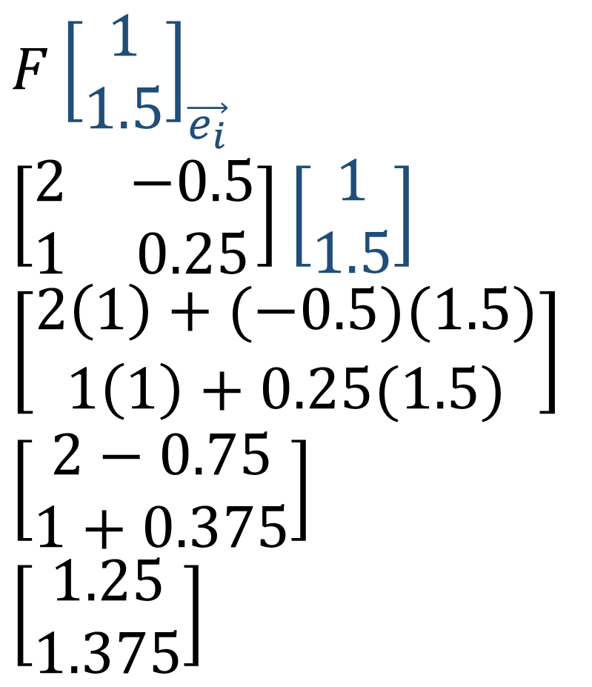
Old Basis: $\{\vec{e_{1}},\vec{e_{2}}\}$
$$F{\left[\begin{matrix}1 \\ 1.5\end{matrix}\right]}_{\vec{e_{i}}}$$
$$\left[\begin{matrix}2 & −0.5 \\ 1 & 0.25\end{matrix}\right]\left[\begin{matrix}1 \\ 1.5\end{matrix}\right]$$
$$\left[\begin{matrix}2\left(1\right)+(−0.5)(1.5) \\ 1\left(1\right)+0.25(1.5)\end{matrix}\right]$$
$$\left[\begin{matrix}2−0.75 \\ 1+0.375\end{matrix}\right]$$
$$\left[\begin{matrix}1.25 \\ 1.375\end{matrix}\right]$$
$$F=\left[\begin{matrix}2 & −\text{½} \\ 1 & \text{¼}\end{matrix}\right]$$
$$B=\left[\begin{matrix}\text{¼} & \text{½} \\ −\text{1} & \text{2}\end{matrix}\right]$$
New Basis: $\{\tilde{\vec{e_{1}}},\tilde{\vec{e_{2}}}\}$
$${\left[\begin{matrix}1 \\ 1.5\end{matrix}\right]}_{\vec{e_{i}}}$$
$${\left[\begin{matrix}1 \\ 2\end{matrix}\right]}_{\tilde{\vec{e_{i}}}}$$

Slide 12

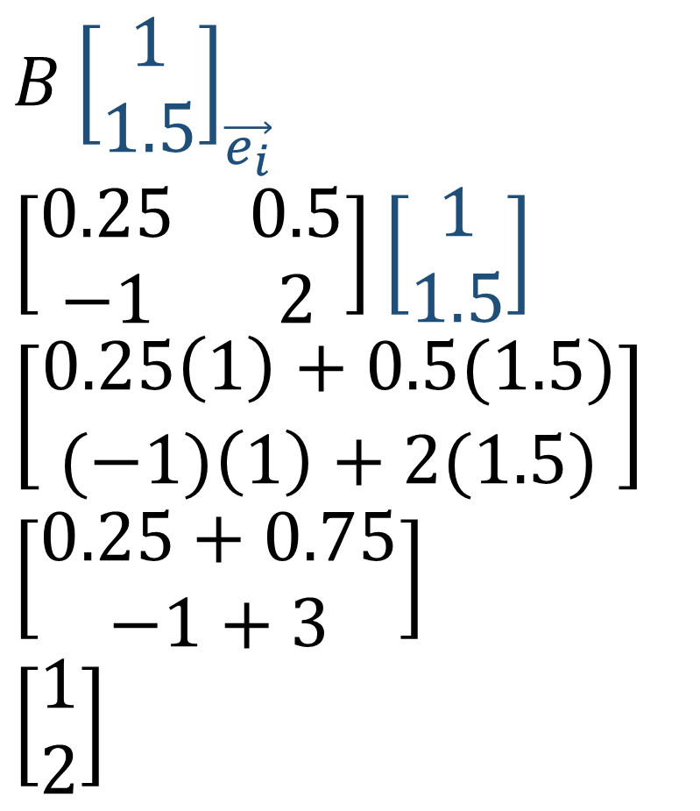
Old Basis: $\{\vec{e_{1}},\vec{e_{2}}\}$
$$B{\left[\begin{matrix}1 \\ 1.5\end{matrix}\right]}_{\vec{e_{i}}}$$
$$\left[\begin{matrix}\text{0.25} & \text{0.5} \\ −\text{1} & \text{2}\end{matrix}\right]\left[\begin{matrix}1 \\ 1.5\end{matrix}\right]$$
$$\left[\begin{matrix}0.25\left(1\right)+0.5(1.5) \\ (−1)\left(1\right)+2(1.5)\end{matrix}\right]$$
$$\left[\begin{matrix}0.25+0.75 \\ −1+3\end{matrix}\right]$$
$$\left[\begin{matrix}1 \\ 2\end{matrix}\right]$$
$$F=\left[\begin{matrix}2 & −\text{½} \\ 1 & \text{¼}\end{matrix}\right]$$
$$B=\left[\begin{matrix}\text{¼} & \text{½} \\ −\text{1} & \text{2}\end{matrix}\right]$$
New Basis: $\{\tilde{\vec{e_{1}}},\tilde{\vec{e_{2}}}\}$
$${\left[\begin{matrix}1 \\ 1.5\end{matrix}\right]}_{\vec{e_{i}}}$$
$${\left[\begin{matrix}1 \\ 2\end{matrix}\right]}_{\tilde{\vec{e_{i}}}}$$

Slide 13
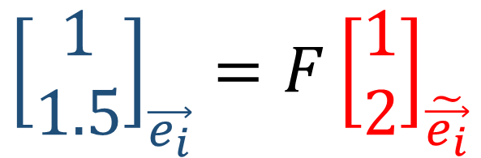
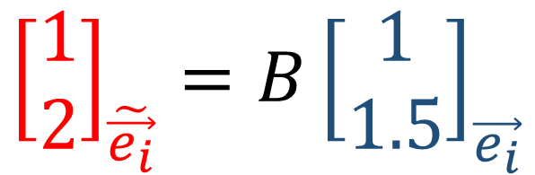

Old Basis: $\{\vec{e_{1}},\vec{e_{2}}\}$
$${\left[\begin{matrix}1 \\ 2\end{matrix}\right]}_{\tilde{\vec{e_{i}}}}=B{\left[\begin{matrix}1 \\ 1.5\end{matrix}\right]}_{\vec{e_{i}}}$$
$$F=\left[\begin{matrix}2 & −\text{½} \\ 1 & \text{¼}\end{matrix}\right]$$
$$B=\left[\begin{matrix}\text{¼} & \text{½} \\ −\text{1} & \text{2}\end{matrix}\right]$$
$${\left[\begin{matrix}1 \\ 1.5\end{matrix}\right]}_{\vec{e_{i}}}=F{\left[\begin{matrix}1 \\ 2\end{matrix}\right]}_{\tilde{\vec{e_{i}}}}$$
New Basis: $\{\tilde{\vec{e_{1}}},\tilde{\vec{e_{2}}}\}$
$${\left[\begin{matrix}1 \\ 1.5\end{matrix}\right]}_{\vec{e_{i}}}$$
$${\left[\begin{matrix}1 \\ 2\end{matrix}\right]}_{\tilde{\vec{e_{i}}}}$$

Slide 14
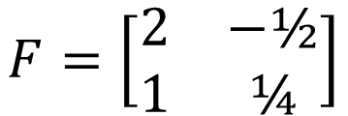


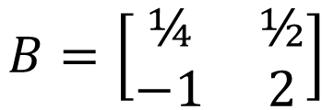
Old Basis: $\{\vec{e_{1}},\vec{e_{2}}\}$
Old Components :${\left[\begin{matrix}1 \\ 1.5\end{matrix}\right]}_{\vec{e_{i}}}$
$$F=\left[\begin{matrix}2 & −\text{½} \\ 1 & \text{¼}\end{matrix}\right]$$
$$B=\left[\begin{matrix}\text{¼} & \text{½} \\ −\text{1} & \text{2}\end{matrix}\right]$$
$$F=\left[\begin{matrix}2 & −\text{½} \\ 1 & \text{¼}\end{matrix}\right]$$
$$B=\left[\begin{matrix}\text{¼} & \text{½} \\ −\text{1} & \text{2}\end{matrix}\right]$$
New Basis: $\{\tilde{\vec{e_{1}}},\tilde{\vec{e_{2}}}\}$
New Components:${\left[\begin{matrix}1 \\ 2\end{matrix}\right]}_{\tilde{\vec{e_{i}}}}$

Slide 15

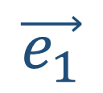

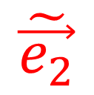
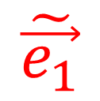
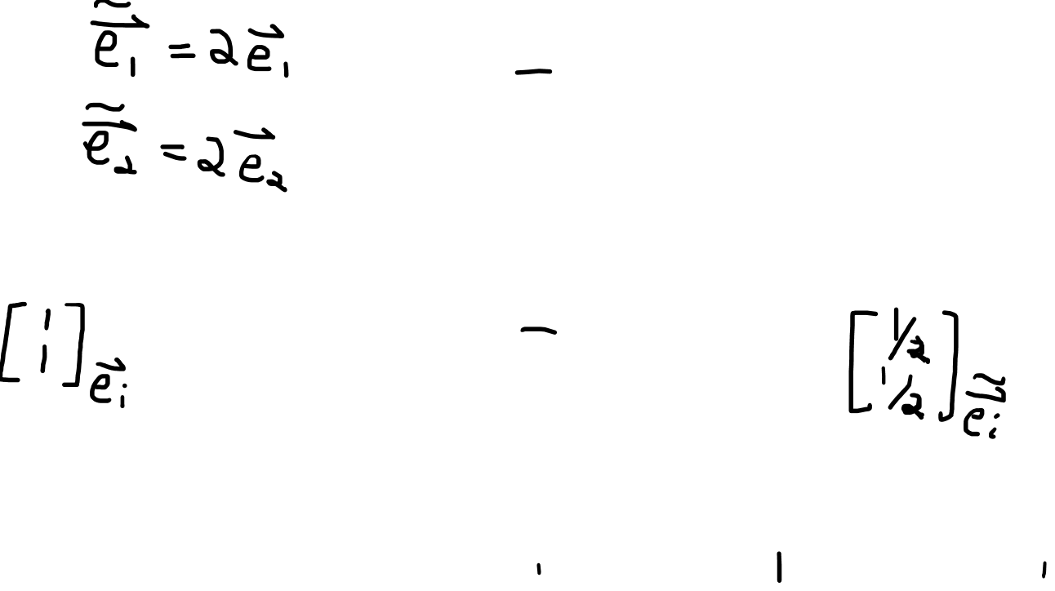
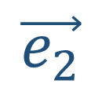
$$\tilde{\vec{e_{2}}}$$
$$\vec{e_{2}}$$
$$\vec{v}$$
$$\vec{v}$$
$$\vec{e_{1}}$$
$$\tilde{\vec{e_{1}}}$$

Slide 16
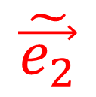


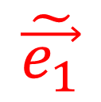
$$\vec{e_{2}}$$
$$\vec{v}$$
$$\tilde{\vec{e_{2}}}$$
$$\vec{v}$$
$$\vec{e_{1}}$$
$$\tilde{\vec{e_{1}}}$$

Slide 17
Old Basis: $\{\vec{e_{1}},\vec{e_{2}}\}$
Old Components :${\left[\begin{matrix}1 \\ 1.5\end{matrix}\right]}_{\vec{e_{i}}}$
$$F=\left[\begin{matrix}2 & −\text{½} \\ 1 & \text{¼}\end{matrix}\right]$$
$$B=\left[\begin{matrix}\text{¼} & \text{½} \\ −\text{1} & \text{2}\end{matrix}\right]$$
$$F=\left[\begin{matrix}2 & −\text{½} \\ 1 & \text{¼}\end{matrix}\right]$$
$$B=\left[\begin{matrix}\text{¼} & \text{½} \\ −\text{1} & \text{2}\end{matrix}\right]$$
New Basis: $\{\tilde{\vec{e_{1}}},\tilde{\vec{e_{2}}}\}$
New Components:${\left[\begin{matrix}1 \\ 2\end{matrix}\right]}_{\tilde{\vec{e_{i}}}}$

Slide 18
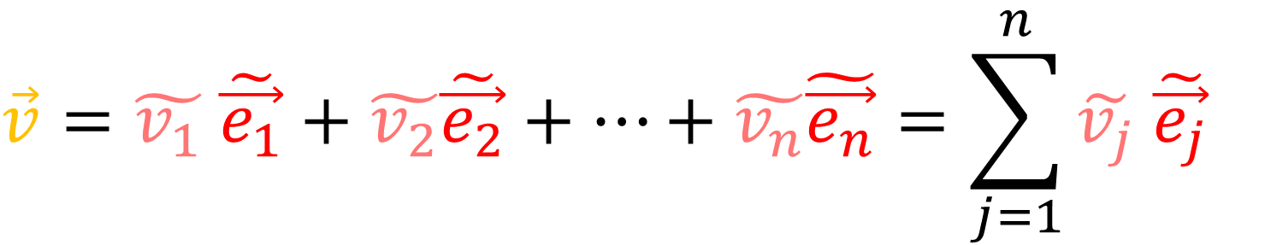
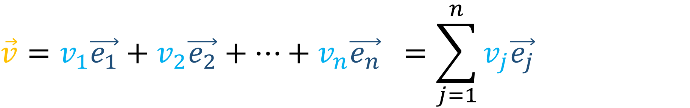
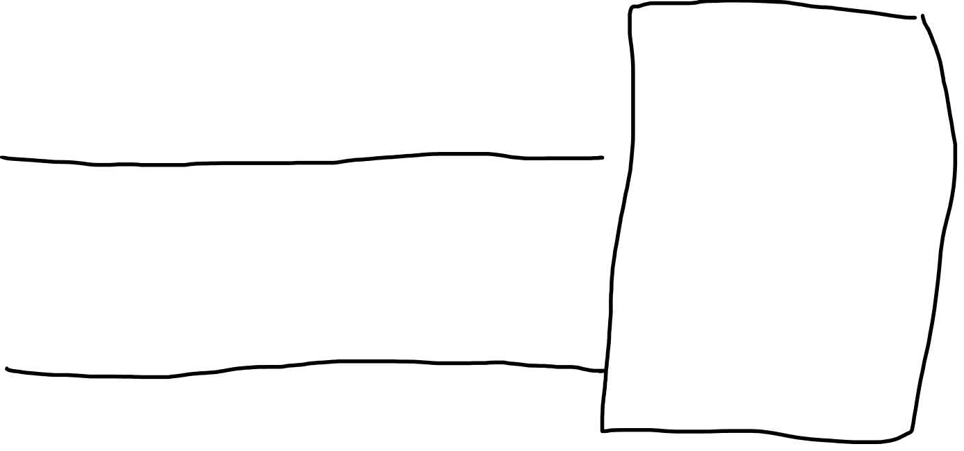
$$\vec{v}=v_{1}\vec{e_{1}}+v_{2}\vec{e_{2}}+…+v_{n}\vec{e_{n}} =\sum_{j=1}^{n}{v_{j}\vec{e_{j}}}$$
$$\vec{v}=\tilde{v_{1}} \tilde{\vec{e_{1}}}+\tilde{v_{2}}\tilde{\vec{e_{2}}}+…+\tilde{v_{n}}\tilde{\vec{e_{n}}}=\sum_{j=1}^{n}{\tilde{v_{j}} \tilde{\vec{e_{j}}}}$$

Slide 19

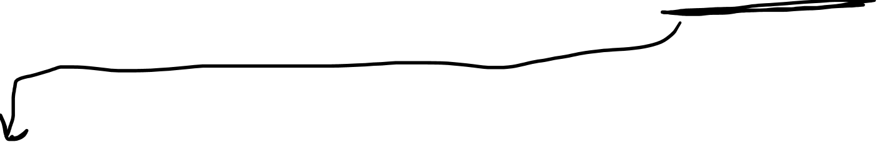



$$\vec{v}=\sum_{j=1}^{n}{v_{j}\vec{e_{j}}}=\sum_{i=1}^{n}{\tilde{v_{i}} \tilde{\vec{e_{i}}}}$$
$$\tilde{\vec{e_{j}}}=\sum_{i=1}^{n}{F_{ij}\vec{e_{i}}}$$
$$\vec{e_{j}}=\sum_{i=1}^{n}{B_{ij}\tilde{\vec{e_{i}}}}$$
$$\vec{v}=\sum_{j=1}^{n}{v_{j}\vec{e_{j}}}=\sum_{j=1}^{n}{v_{j}}\left(\sum_{i=1}^{n}{B_{ij}\tilde{\vec{e_{i}}}}\right)=\sum_{i=1}^{n}{\left(\sum_{j=1}^{n}{B_{ij}v_{j}}\right)}\tilde{\vec{e_{i}}}$$

Slide 20
$$\vec{v}=\sum_{j=1}^{n}{v_{j}\vec{e_{j}}}=\sum_{i=1}^{n}{\tilde{v_{i}} \tilde{\vec{e_{i}}}}$$
$$\tilde{\vec{e_{j}}}=\sum_{i=1}^{n}{F_{ij}\vec{e_{i}}}$$
$$\vec{e_{j}}=\sum_{i=1}^{n}{B_{ij}\tilde{\vec{e_{i}}}}$$
$$\vec{v}=\sum_{j=1}^{n}{v_{j}\vec{e_{j}}}=\sum_{j=1}^{n}{v_{j}}\left(\sum_{i=1}^{n}{B_{ij}\tilde{\vec{e_{i}}}}\right)=\sum_{i=1}^{n}{\left(\sum_{j=1}^{n}{B_{ij}v_{j}}\right)}\tilde{\vec{e_{i}}}$$

Slide 21

$$\vec{v}=\sum_{j=1}^{n}{v_{j}\vec{e_{j}}}=\sum_{i=1}^{n}{\tilde{v_{i}} \tilde{\vec{e_{i}}}}$$
$$\tilde{\vec{e_{j}}}=\sum_{i=1}^{n}{F_{ij}\vec{e_{i}}}$$
$$\vec{e_{j}}=\sum_{i=1}^{n}{B_{ij}\tilde{\vec{e_{i}}}}$$
$$\vec{v}=\sum_{j=1}^{n}{v_{j}\vec{e_{j}}}=\sum_{j=1}^{n}{v_{j}}\left(\sum_{i=1}^{n}{B_{ij}\tilde{\vec{e_{i}}}}\right)=\sum_{i=1}^{n}{\left(\sum_{j=1}^{n}{B_{ij}v_{j}}\right)}\tilde{\vec{e_{i}}}$$

Slide 22

$$\vec{v}=\sum_{j=1}^{n}{v_{j}\vec{e_{j}}}=\sum_{i=1}^{n}{\tilde{v_{i}} \tilde{\vec{e_{i}}}}$$
$$\tilde{\vec{e_{j}}}=\sum_{i=1}^{n}{F_{ij}\vec{e_{i}}}$$
$$\vec{e_{j}}=\sum_{i=1}^{n}{B_{ij}\tilde{\vec{e_{i}}}}$$
$$\vec{v}=\sum_{j=1}^{n}{v_{j}\vec{e_{j}}}=\sum_{j=1}^{n}{v_{j}}\left(\sum_{i=1}^{n}{B_{ij}\tilde{\vec{e_{i}}}}\right)=\sum_{i=1}^{n}{\left(\sum_{j=1}^{n}{B_{ij}v_{j}}\right)}\tilde{\vec{e_{i}}}$$
$$\tilde{v_{i}}=\sum_{j=1}^{n}{B_{ij}v_{j}}$$

Slide 23




$$\vec{v}=\sum_{i=1}^{n}{v_{i}\vec{e_{i}}}=\sum_{j=1}^{n}{\tilde{v_{j}} \tilde{\vec{e_{j}}}}$$
$$\tilde{\vec{e_{j}}}=\sum_{i=1}^{n}{F_{ij}\vec{e_{i}}}$$
$$\vec{e_{j}}=\sum_{i=1}^{n}{B_{ij}\tilde{\vec{e_{i}}}}$$
$$\vec{v}=\sum_{j=1}^{n}{\tilde{v_{j}} \tilde{\vec{e_{j}}}}=\sum_{j=1}^{n}{\tilde{v_{j}}}\left(\sum_{i=1}^{n}{F_{ij}\vec{e_{i}}}\right)=\sum_{i=1}^{n}{\left(\sum_{j=1}^{n}{F_{ij}\tilde{v_{j}}}\right)}\vec{e_{i}}$$
$$v_{i}=\sum_{j=1}^{n}{F_{ij}\tilde{v_{j}}}$$

Slide 24




$$\tilde{\vec{e_{j}}}=\sum_{i=1}^{n}{F_{ij}\vec{e_{i}}}$$
$$\tilde{v_{i}}=\sum_{j=1}^{n}{B_{ij}v_{j}}$$
$$\vec{e_{j}}=\sum_{i=1}^{n}{B_{ij}\tilde{\vec{e_{i}}}}$$
$$v_{i}=\sum_{j=1}^{n}{F_{ij}\tilde{v_{j}}}$$

Slide 25
Contravariant
$$\tilde{\vec{e_{j}}}=\sum_{i=1}^{n}{F_{ij}\vec{e_{i}}}$$
$$\tilde{v_{i}}=\sum_{j=1}^{n}{B_{ij}v_{j}}$$
$$\vec{e_{j}}=\sum_{i=1}^{n}{B_{ij}\tilde{\vec{e_{i}}}}$$
$$v_{i}=\sum_{j=1}^{n}{F_{ij}\tilde{v_{j}}}$$

Slide 26

$$\vec{v}=\sum_{i=1}^{n}{v_{i}\vec{e_{i}}}=\sum_{i=1}^{n}{\tilde{v_{i}} \tilde{\vec{e_{i}}}}$$

Slide 27


$$\vec{v}=\sum_{i=1}^{n}{v^{i}\vec{e_{i}}}=\sum_{i=1}^{n}{\tilde{v^{i}} \tilde{\vec{e_{i}}}}$$

